Slide 1

Student Performance Analytics Dashboard
Data Science
Team Members:
A.Srija-2420030062
I.Srivalli-2420030742

Slide 2
Problem Statement:
Student performance data contains many factors such as marks, study time, attendance, absences and previous grades.
Analyzing this data manually is difficult and time-consuming.
It is difficult to identify patterns and students who may need additional support.
A simple interactive system is needed to convert student data into clear visual insights.

Slide 3
Real-World Relevance:
Helps educators understand student performance.
Helps identify factors affecting academic results.
Supports early identification of students who may need help.
Supports data-driven academic decisions
Motivation:
Large amounts of student data are available.
Raw data is difficult to understand directly.
Data visualization can make performance patterns easier to understand.

Slide 4
Objectives:
Analyze student academic performance using Python.
Clean and prepare student performance data.
Identify relationships between attendance, study time and marks.
Visualize performance using different charts.
Develop an interactive Streamlit dashboard.
Provide simple insights that help educators understand student performance

Slide 5
Expected Outcomes:
Interactive student performance dashboard.
Average marks and attendance analysis.
Study-hours analysis.
Grade distribution visualization.
Correlation analysis between important factors.
Easy identification of performance patterns.
Better support for data-driven decision-making.

Slide 6
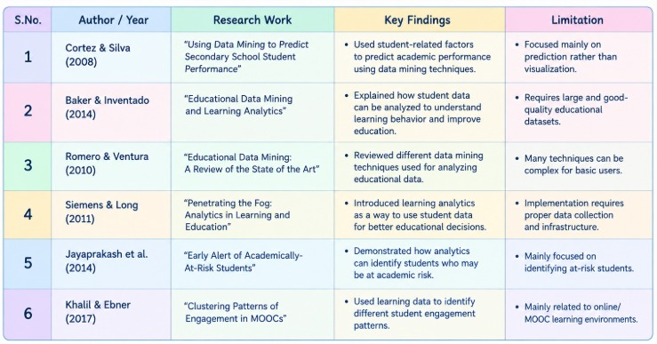
Literature Survey / Existing System:

Slide 7
Limitations / Research Gap:
Manual analysis takes time.
Raw data is difficult to interpret.
Basic systems may provide limited visual analysis.
Relationships between different factors may not be clearly visible.
Some systems are not interactive or easy to use.
There is a need for a simple, interactive and easy-to-understand
dashboard
that combines student performance data with multiple visual and
correlation analyses.

Slide 8
Proposed System:
Student Dataset → Data Cleaning → Data Analysis → Visualization → Streamlit Dashboard
Uses Pandas and NumPy for data processing.
Uses Matplotlib and Seaborn for visualization.
Uses Streamlit to create an interactive dashboard.
Shows important performance indicators and relationships.
Can optionally include Machine Learning for score prediction.

Slide 9
How Proposed System Addresses the Gap:
Existing Problem: | Proposed Solution:
Manual analysis | Automated data analysis
Difficult to understand raw data | Visual charts
Limited insights | Multiple performance factors
Static analysis | Interactive Streamlit dashboard
Difficult comparison | KPI and correlation analysis

Slide 10
Conclusion:
The project converts raw student data into simple visual insights.
It helps understand factors related to academic performance.
The interactive dashboard makes analysis easier for educators.
The system can support data-driven academic decision-making.

